Slide 1
Edge Computing
Lecture 02: Edge Computing & Applications

Slide 2
Agenda
Edge computing evolution
Virtualization & containers
Application case study
Edge AI App: design to deployment

Slide 3
Edge Computing
Is a paradigm (model, standard, pattern), subset of distributed computing, that pushes computational logic towards wherever data is generated.

Slide 4
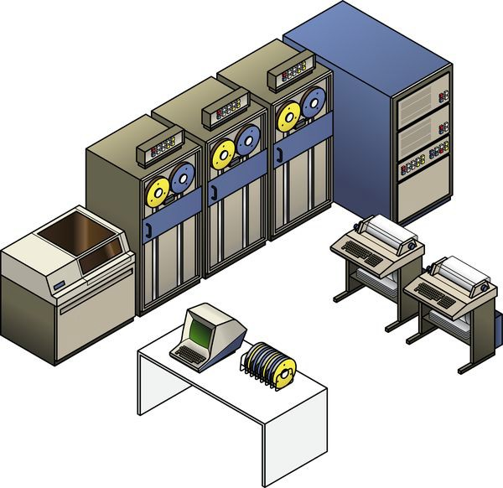
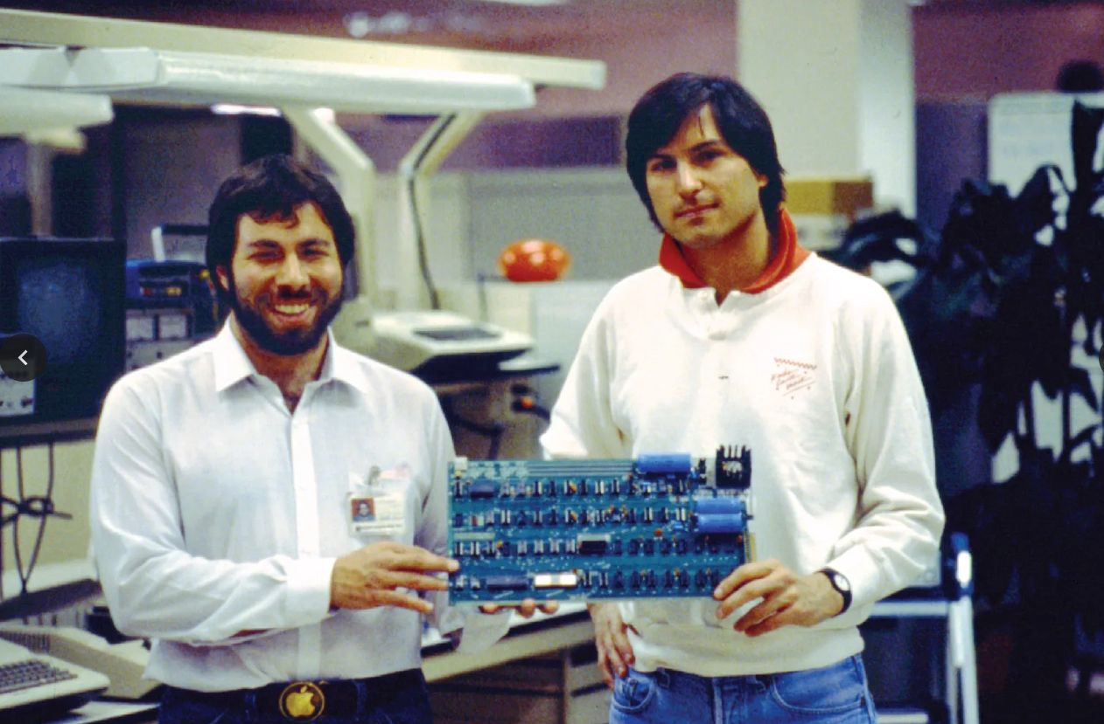
The Evolution (Push & Pull)
Gigantic computer (Central)
E.g. IBM mainframe (1964), $5B
Terminal
Rendering letters
PCs (Dist.)
Standalone computation
Apple I (1976)
Steve Wozniak & Steve Jobs
Situnayake, D., & Plunkett, J. (2023). AI at the Edge. O'Reilly

Slide 5
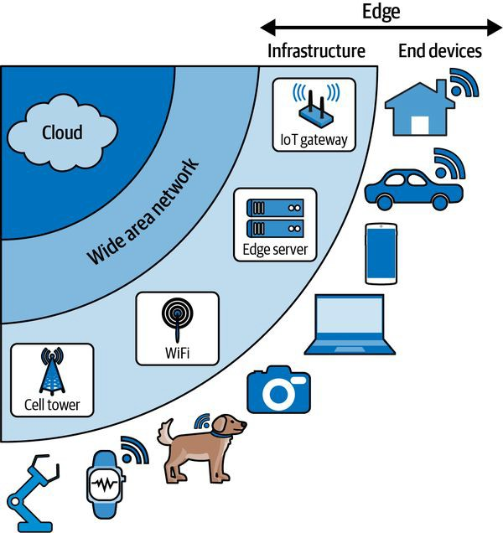
The Evolution (Push & Pull)
Cloud computing (2000, Central)
Growth of Internet (since 1983)
Web applications, remote servers
Data Centers, Content Distribution Network (CDN)
Everything tethered to the cloud
Network is indispensable
Edge computing (Dist.)
Cloudlet (CMU, 2009), for CDN
Fog computing (Cisco, 2012)
Mobile Edge Computing (ETSI, 2014)
IoT, 12.2 B connected devices as of 2021
What’s next? (Cent.?)
Situnayake, D., & Plunkett, J. (2023). AI at the Edge. O'Reilly

Slide 6
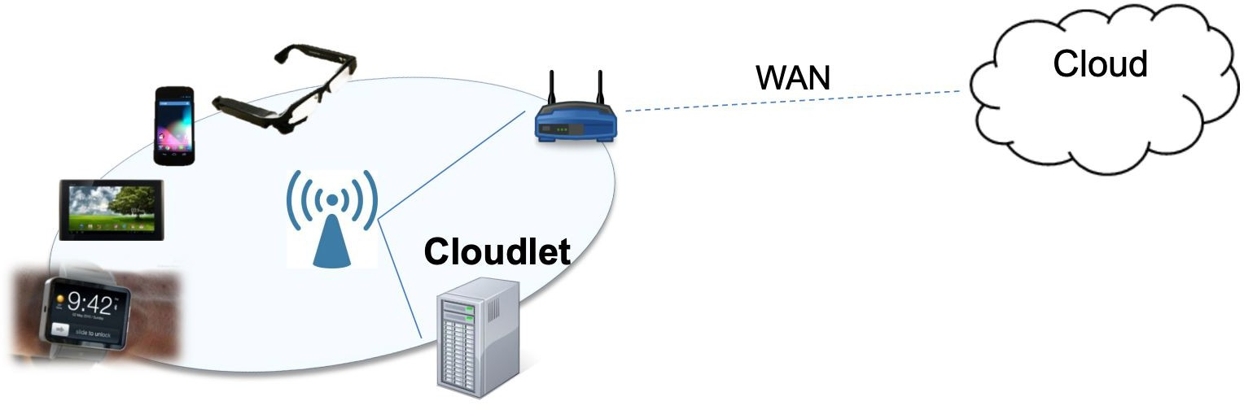
Cloud View
Cloud Provider
Data (YouTube, NetFlix)
Web App (Amazon, Gmail)
Communication (FaceTime, Twitter, Facebook)
How to serve different requests?
Customization?
Cloudlets: at the Leading Edge of MobileCloud Convergence

Slide 7
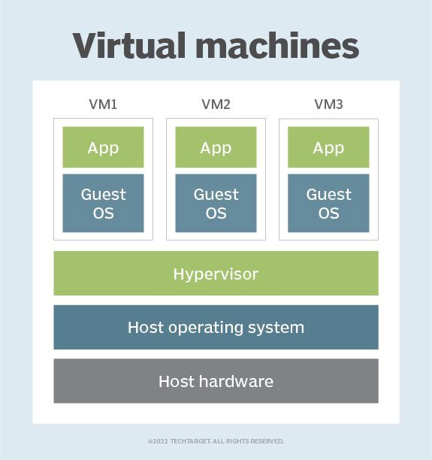
Customized Cloudlet: Virtualization
Virtualization
Same physical machines
Dynamically provision the resources (CPU, RAM, etc.) upon usage
Hardware transparent to users
Virtual machines
A software system to emulate one independent physical machine
e.g. VirtualBox

Slide 8
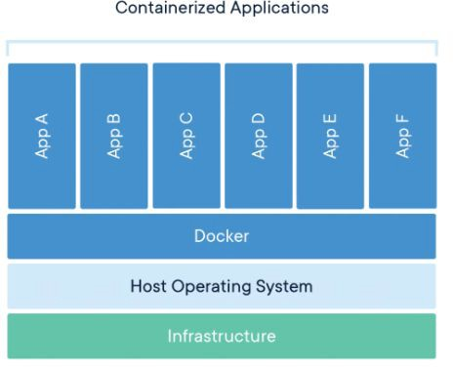
Customized Cloudlet: Virtualization
Virtualization
Same physical machines
Dynamically provision the resources (CPU, RAM, etc.) upon usage
Hardware transparent to users
Virtual machines
A software system to emulate one independent physical machine
e.g. VirtualBox, Microsoft Azure
Container
A software package of an application and its dependencies
e.g. Docker, Kubernetes

Slide 9
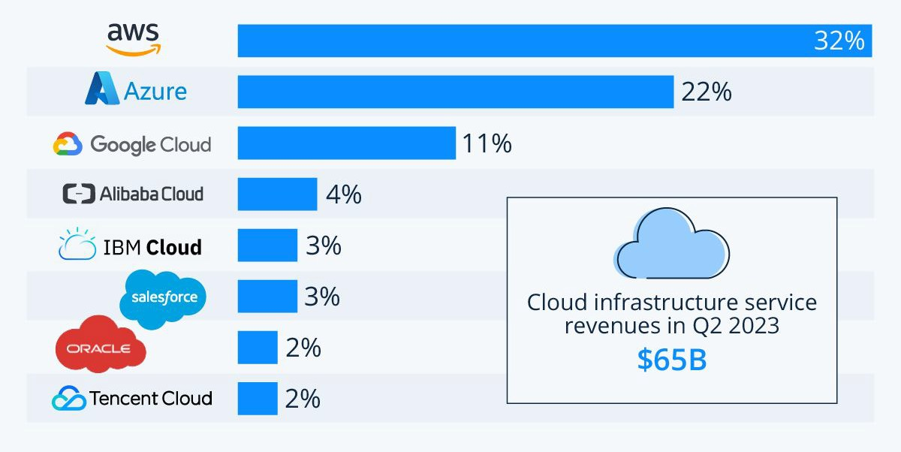
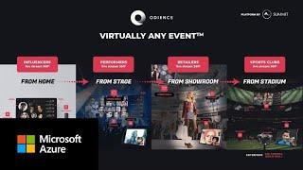
Business Model: Getting closer to users
Cloud Providers ● Internet Service Providers (ISPs)
Microsoft, Azure IoT Edge
Amazon, CloudFront
Google
AT&T
Verizon
T-Mobile
https://www.statista.com/chart/18819/worldwide-market-share-of-leading-cloud-infrastructure-service-providers/

Slide 10
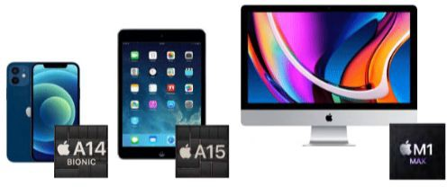
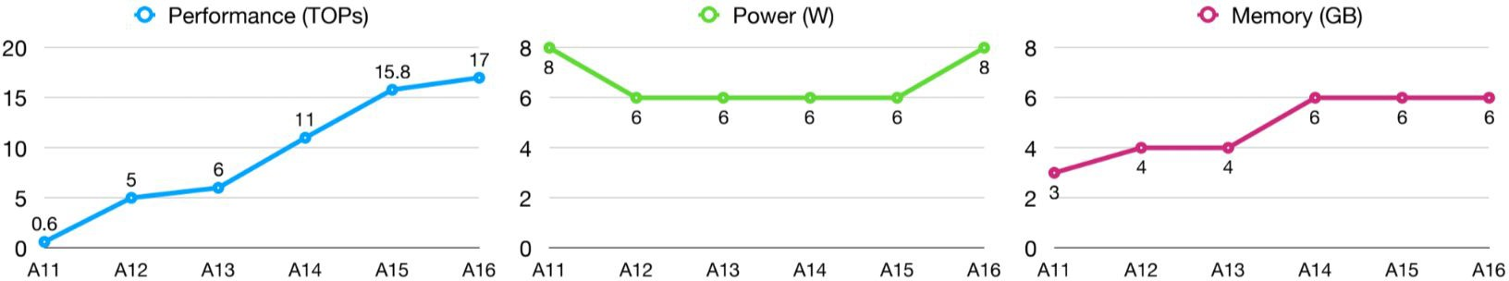
Edge View
Growing local computation
Provided with enough compute, local is the fastest
Apple Neural Engine
https://nanoreview.net/en & Song, Han, EfficientML.ai

Slide 11
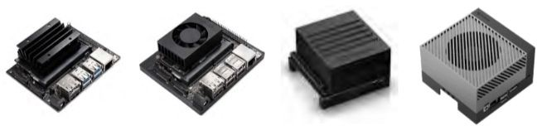
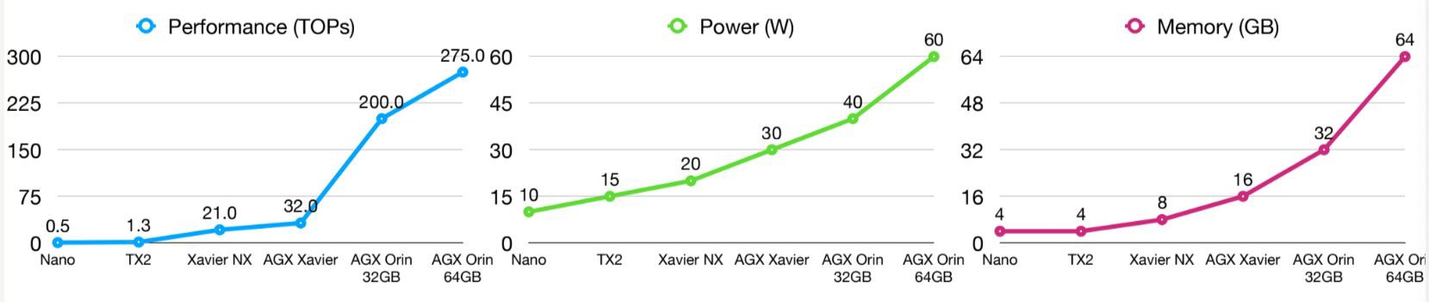
Edge View
Nvidia Jetson
Custom boards vs Dev boards
Nano
Xavier
AGX
Xavier
Orin
https://connecttech.com/jetson/jetson-module-comparison/ & Song, Han, EfficientML.ai

Slide 12
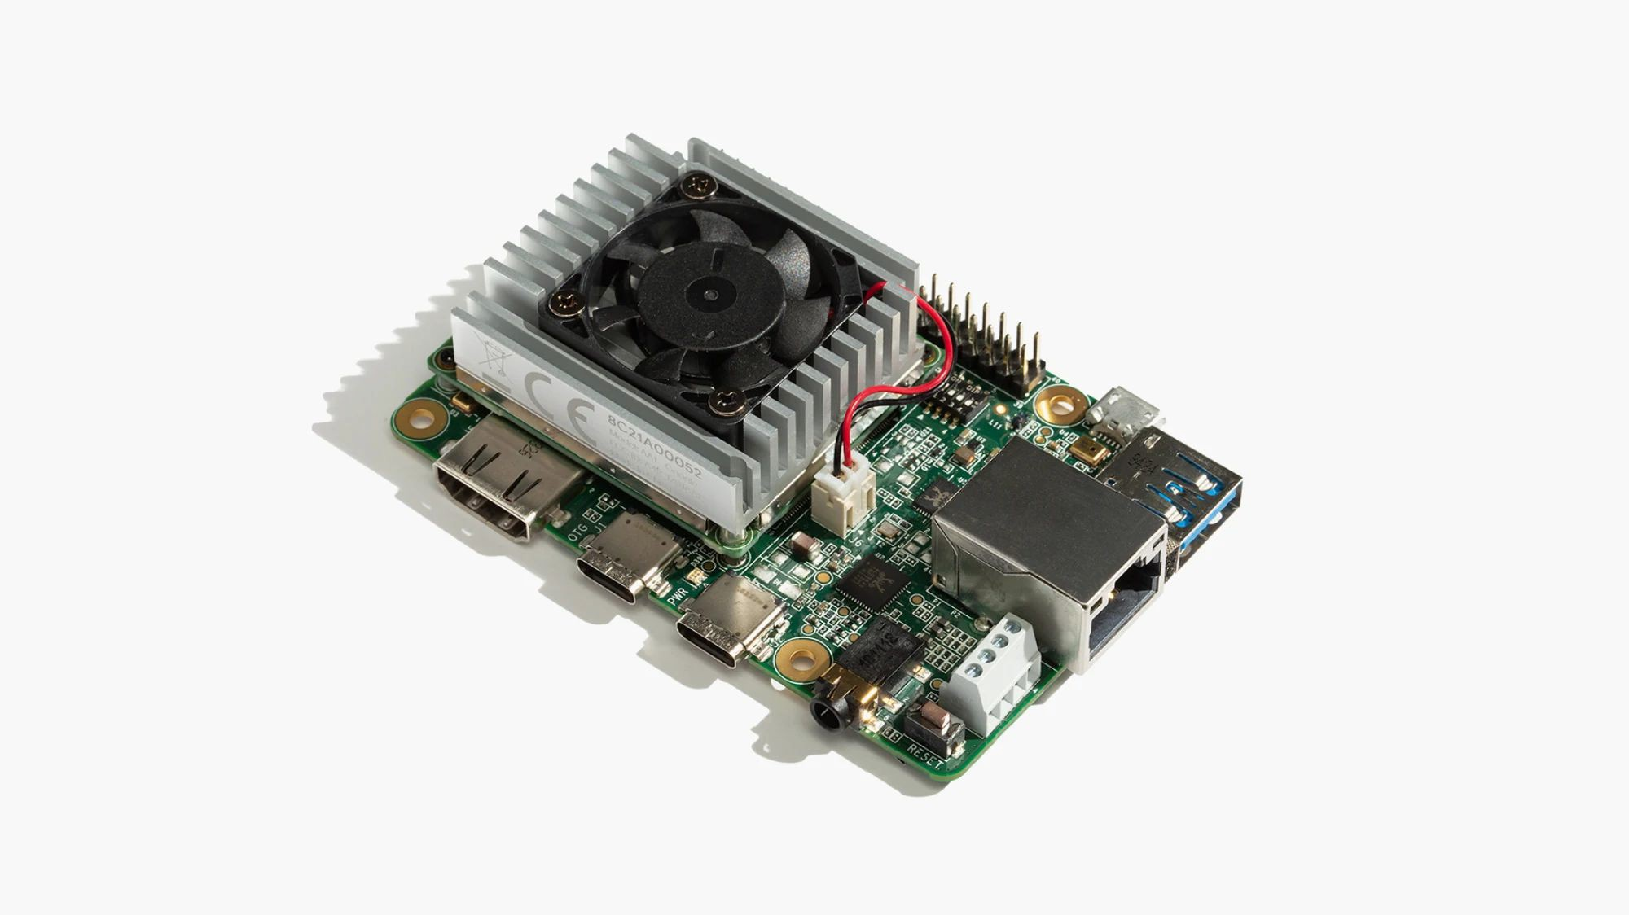
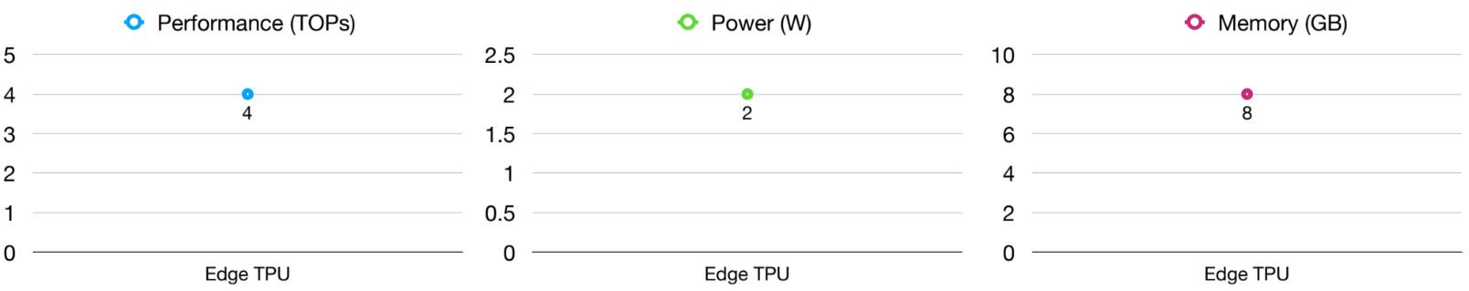
Edge View
Google Tensor Processing Unit (TPU)
Equipped since Pixel 6
https://en.wikipedia.org/wiki/Tensor_Processing_Unit & Song, Han, EfficientML.ai

Slide 13
Edge View
Efficient ML / Tiny ML
Quantization
Pruning
Network architecture search
Explainable AI (XAI) for feature selection
Offloading / Slicing
Lazy execution (on / off switch on edge)
Model / network / compute slicing

Slide 14
Cent. vs Dist.: Drivers
1st Gen Computer -> PC
PC -> Cloud computing
Cloud computing -> Edge computing

Slide 15
Cent. vs Dist.: Drivers
1st Gen Computer -> PC
PC -> Cloud computing
Cloud computing -> Edge computing (BLERP)
Bandwidth
Latency
Economics
Reliability
Privacy
Situnayake, D., & Plunkett, J. (2023). AI at the Edge. O'Reilly

Slide 16
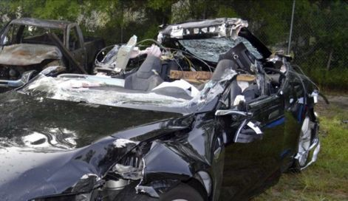
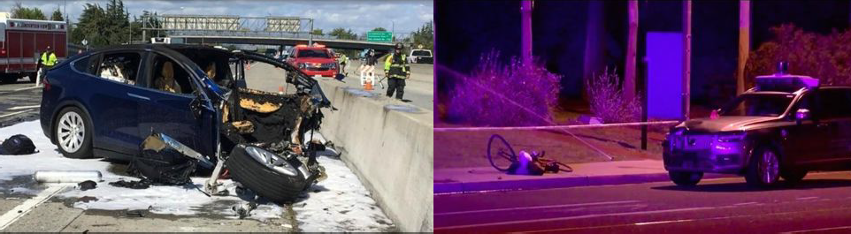
Responsible Design & AI Ethics
Tesla, May 2016, March 2018
Uber, Mar 2018

Slide 17
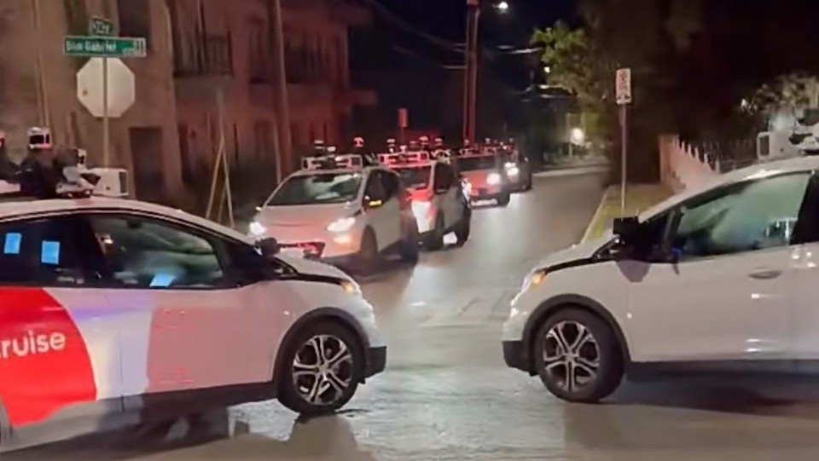
Sep 2023, Austin, Texas

Slide 18


Slide 19
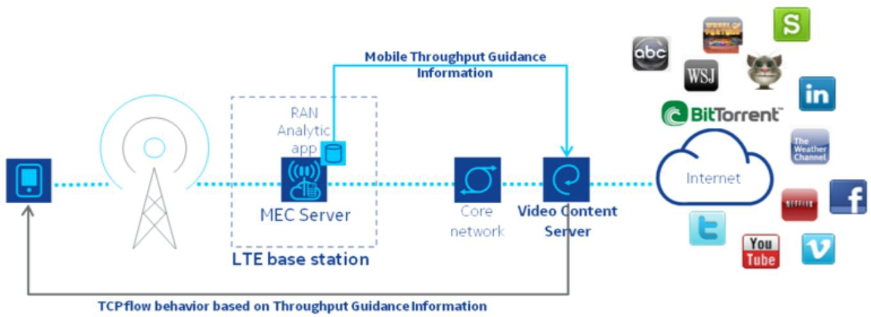
Edge Computing Applications
Video Streaming
Where is the content?
How to speed up the streaming?

Slide 20
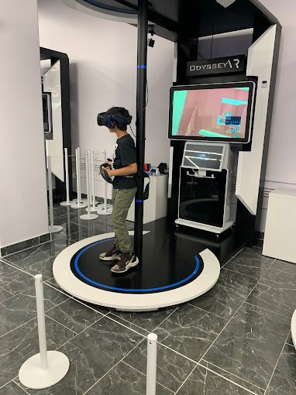
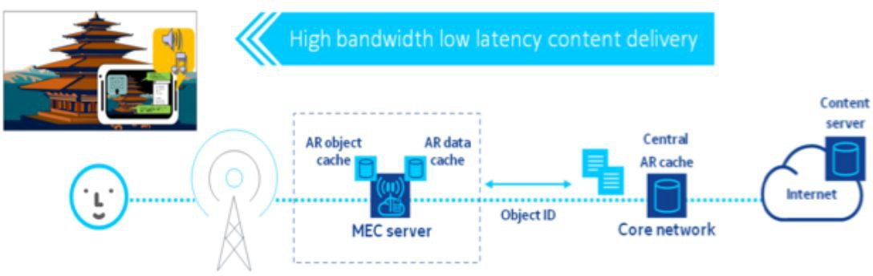
Edge Computing Applications
AR/VR
How is content delivered?
Where does 3D rendering happen?
https://lh3.googleusercontent.com/p/AF1QipMa0drbYS-V30IcmHJJz5gP2oMMDjBcssFFEUnX=s680-w680-h510

Slide 21
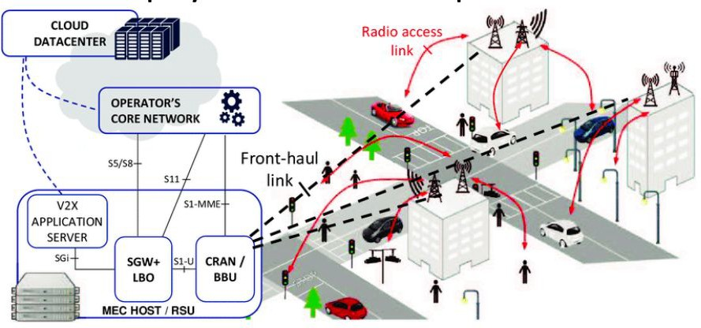
Edge Computing Applications
Transportation
How can edge computing help?

Slide 22
Edge Computing Applications (Project Ideas)
Type of Applications
Keeping Track of Objects
Understanding and Controlling Systems
Understanding People and Living Things
Transforming Signals
Situnayake, D., & Plunkett, J. (2023). AI at the Edge. O'Reilly

Slide 23
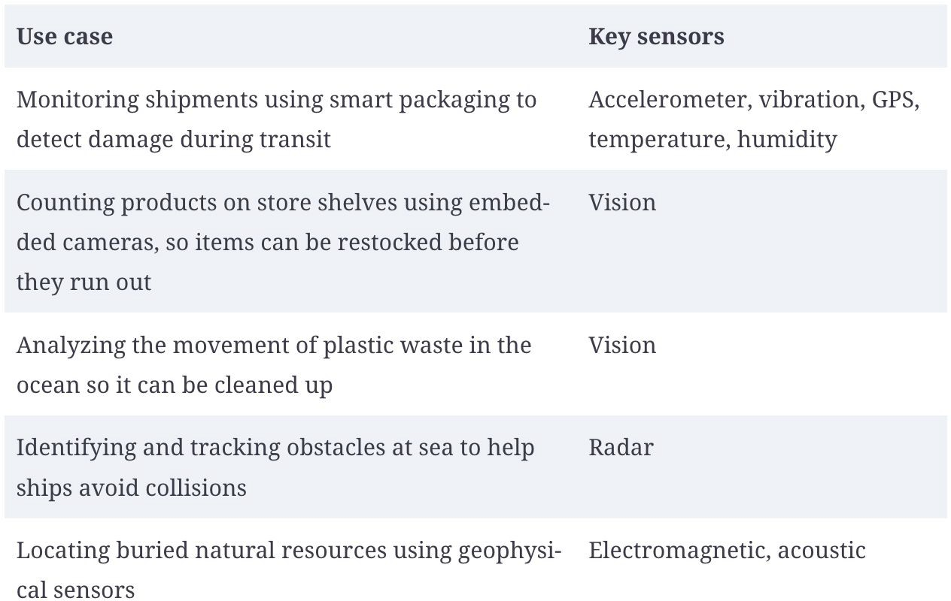
Keep Track of Things
BLERP
Bandwidth | Y
Latency | N
Economics | Y
Reliability | Y
Privacy | N
Situnayake, D., & Plunkett, J. (2023). AI at the Edge. O'Reilly

Slide 24
Understanding & Controlling Systems
BLERP
Bandwidth | Y
Latency | Y
Economics | Y
Reliability | Y
Privacy | N
Situnayake, D., & Plunkett, J. (2023). AI at the Edge. O'Reilly

Slide 25
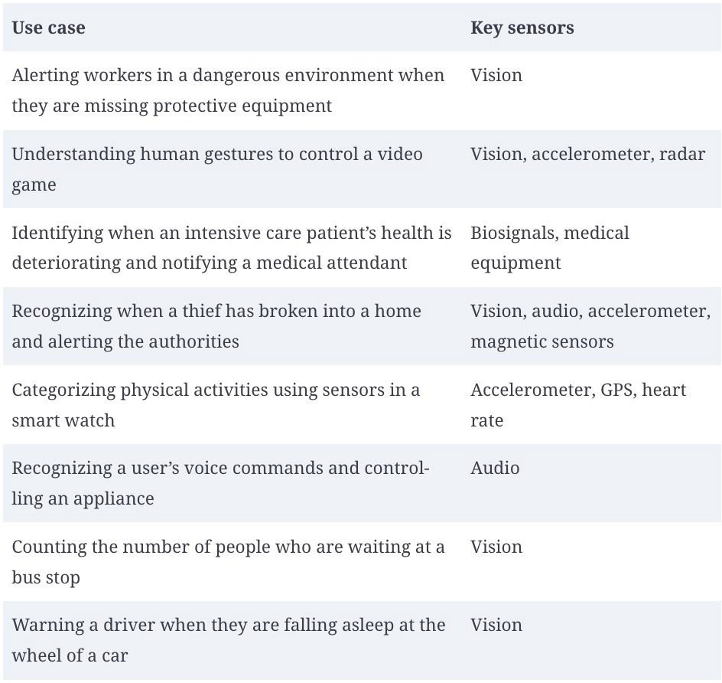
Human-centered Apps
BLERP
Bandwidth | Y
Latency | Y
Economics | Y
Reliability | Y
Privacy | Y
Situnayake, D., & Plunkett, J. (2023). AI at the Edge. O'Reilly

Slide 26
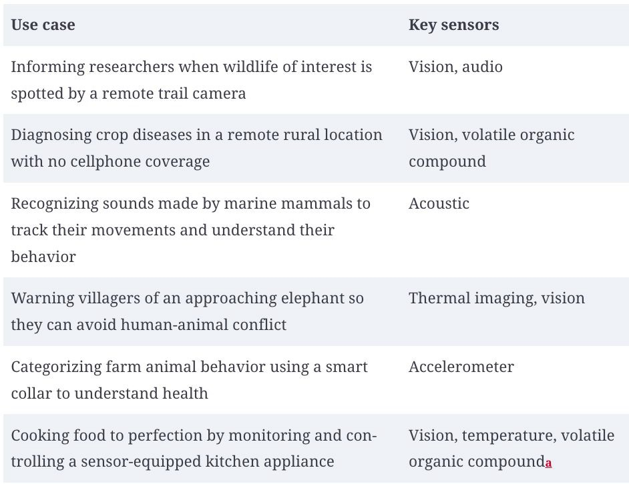
Apps Involving Living Things
BLERP
Bandwidth | Y
Latency | Y
Economics | Y
Reliability | Y
Privacy | Y

Slide 27
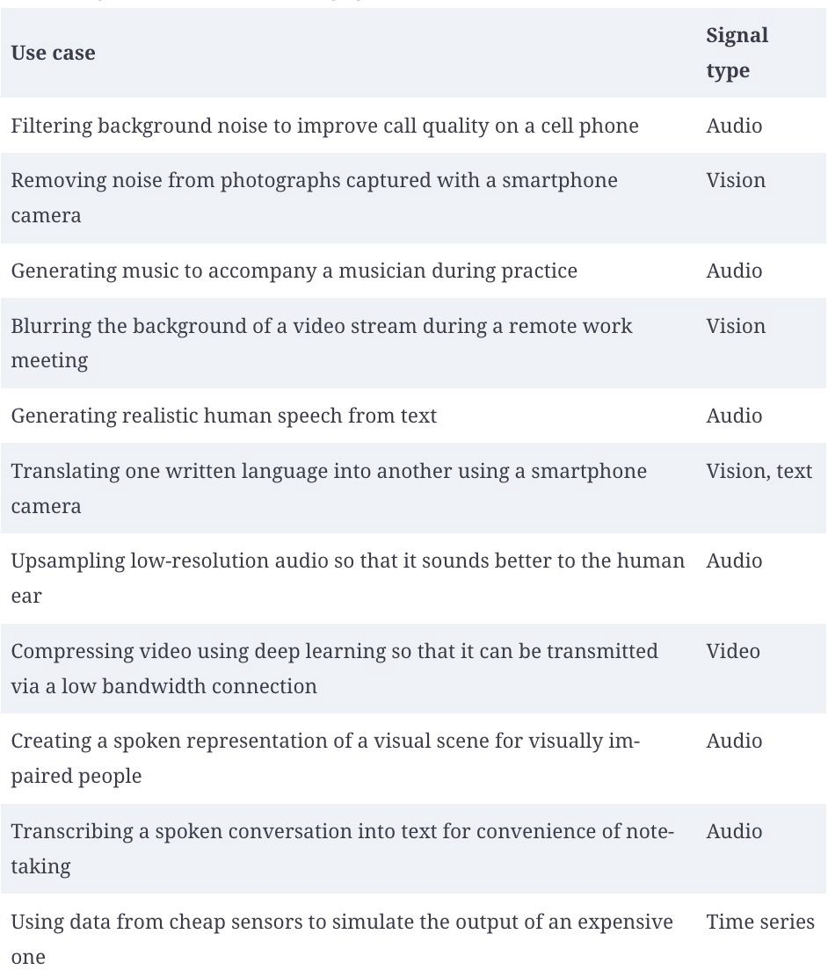
Transforming Signals
BLERP
Bandwidth | Y
Latency | Y
Economics | Y
Reliability | Y
Privacy | Y

Slide 28
Edge AI App: Design to Deployment
Finding the problem to solve (what is the pain point?)
Building a dataset
Design an application
Iteration, iteration, iteration
Testing, deployment, and monitoring
Situnayake, D., & Plunkett, J. (2023). AI at the Edge. O'Reilly

Slide 29
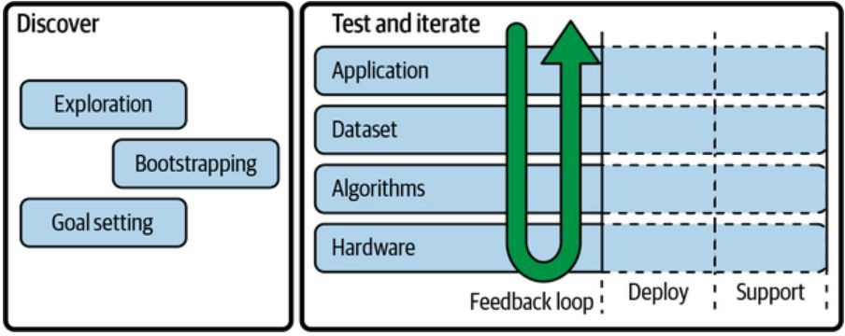
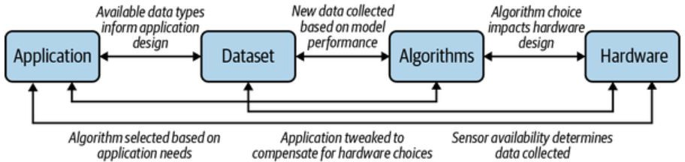
Edge AI Workflow: Intertwined
Situnayake, D., & Plunkett, J. (2023). AI at the Edge. O'Reilly

Slide 30
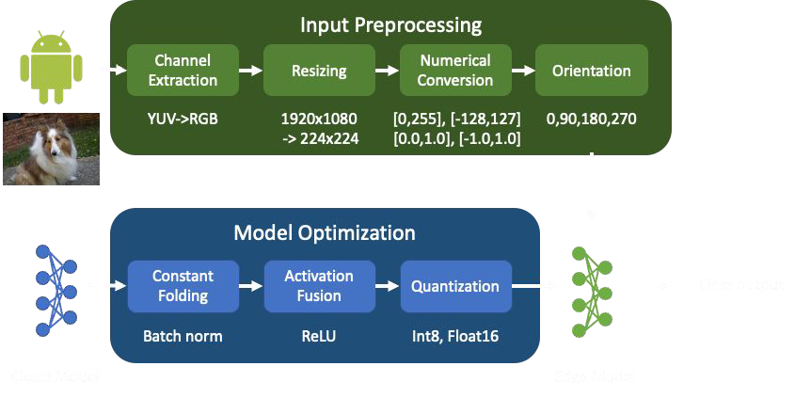

Deployment Example: Image Classifier on Android
Cloud Model
Edge Model

Slide 31
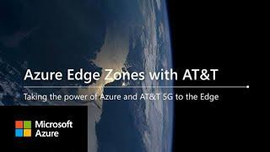
Deployment Example: Azure VMs on AT&T

Slide 32
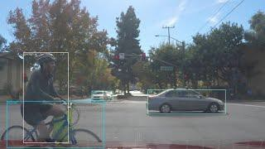
Monitoring and Support

Slide 33
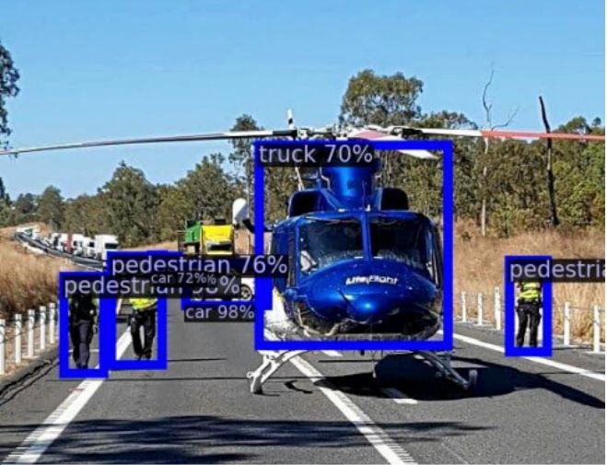
Monitoring and Support
Design a monitoring approach
Mining the failure mode
Resolve the failure online
Remote operation
Continual learning

Slide 34
Summary
Evolution of computing paradigm
Cloud vs Edge View
Virtualization
Applications
From design to deployment

Slide 35
Next Lecture
Edge systems architectures
Lab 1: performance profiling
Design and optimization

